Slide 1
104KM Enterprise Information System
Topic: Systems Analysis and Design – Part 2
Learning outcomes for today
Normalization
Data Redundancy
Functional Dependency
Process of Normalization
Summary

Slide 2
Normalization
Is a database technique that starts by examining the functional dependencies (Relationship) between attributes.
It employs a series of test (called normal forms) to identify the optimal grouping of attributes that support the enterprise’s data requirement.
Normalization is a technique for producing a set of relations with desirable properties, given the data requirement of an enterprise

Slide 3
Purpose of Normalization
Recalling that normalization is a technique for producing a set of relations with desirable properties, given the data requirement of an enterprise. We could say it’s purpose is to identify a suitable set of relations that supports the data requirement of an enterprise.
A database with a suitable set of relations is easier for the user to access and maintain the data whilst taking minimal storage space on the computer.

Slide 4
Purpose of Normalization
The characteristics used to identify a set of relations includes the following:
The minimal number of attributes necessary to support the data requirements of the enterprise;
Attributes with a close logical relationship (described as functional dependency) are found in the same relation;
Minimal redundancy, with each attribute represented only once, with the important exception of attributes that form all or part of foreign keys, which are essential for the joining of related relations.

Slide 5
How Normalization Supports Database Design
There are two main approaches for using Normalization;
Bottom-Up technique
Validation technique
Both approaches are aimed at creating a set of well-designed relations that meet the data requirements of the enterprise.

Slide 6
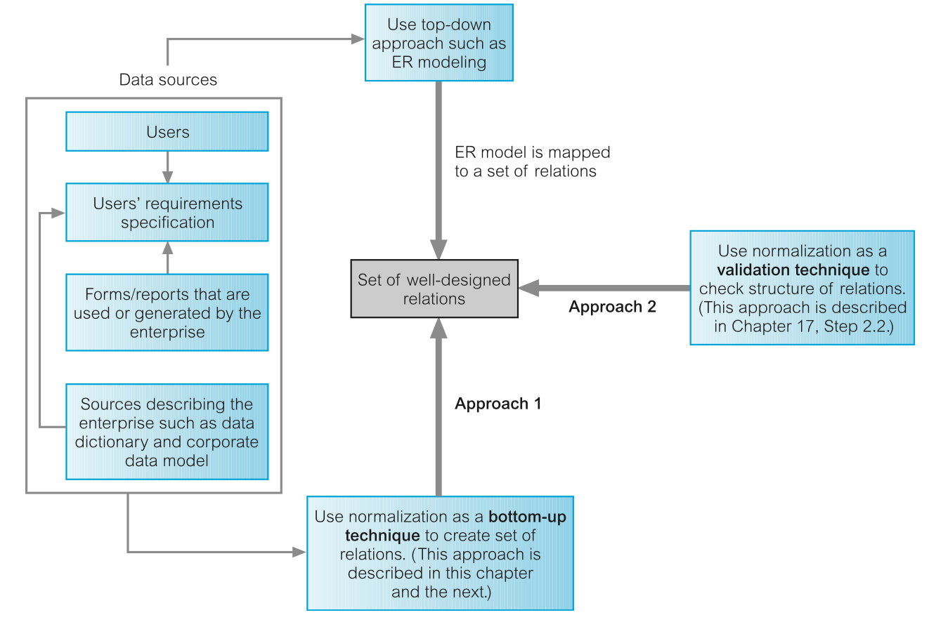
How Normalization Supports Database Design

Slide 7
Data Redundancy and Update Anomalies
Recalling, the main aim of database design is to group attributes into relations in order to minimize data redundancy.
The potential benefits for the implemented database includes;
Reducing data inconsistencies as a result to data update in the database
Reducing cost as a result of reduction in storage space

Slide 8
Data Redundancy and Update Anomalies
Relational database also relies on the existence of a certain amount of data redundancy
This redundancy is in the form of copies of primary keys (or candidate keys) acting as foreign keys in related relations to enable modelling of relationships between data.

Slide 9
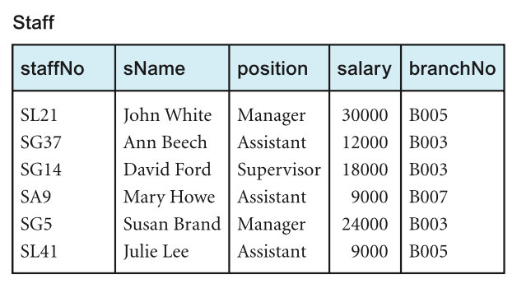
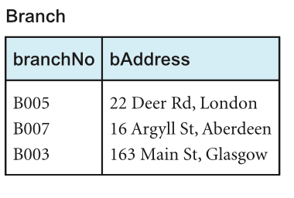
Example *
Let’s consider the Staff and Branch relation below with the relation having the following form
Staff (staffNo, sName, position, salary, branchNo)
Branch (branchNo, bAddress)
StaffBranch (staffNo, sName, position, salary, branchNo, bAddress)

Slide 10
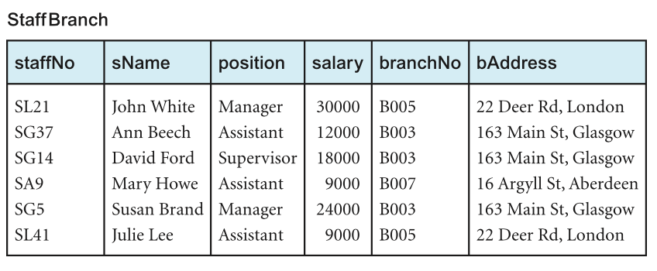
Example *
The problem associated with unwanted data redundancy can be illustrated by comparing the staff and Branch relations with the StaffBranch relation below

Slide 11
Example *
In the StaffBranch relation there is redundant data;
The details of a branch are repeated for every member of staff located at that branch.
In contrast;
The branch details appear only once for each branch in the Branch relation.
Only the branch number branchNo is repeated in the Staff relation to represent where each member of staff is located.
Relations that have redundant data may have problems called update anomalies, which are classified as insertion, deletion, or modification anomalies.

Slide 12
Insertion Anomalies
Insertion Anomaly occurs when certain attributes cannot be inserted into the database without the presence of another.
There are two main types of insertion anomaly, illustrated using the StaffBranch relation.
Inserting the details of a new staff member requires inclusion of the branch which the staff would be based.
Inserting details of a new branch that currently has no staff requires entering nulls into the attributes for staff. However, as staffNo is the primary key for the StaffBranch relation, attempting to enter nulls for staffNo violates entity integrity, and is not allowed.

Slide 13
Deletion Anomalies
Deletion Anomaly occurs when certain attributes are lost because of deletion of another attribute.
Deleting tuple from StaffBranch relation that represents the last member of staff located at a branch, the details about that branch are also lost from the database. E.g. deleting the tuple for SA9 (Mary Howe) from the StaffBranch relation, the details relating to branch number B007 are lost from the database.

Slide 14
Modification Anomalies
Modification Anomaly occurs when there is a change (addition, substitution or deletion) of data from the database.
Changing one attribute of a particular branch in the StaffBranch relation (e.g. address for branch B003), we must update the tuples of all staff located at that branch. Failure to do would result in inconsistence in the database (e.g. branch B003 may appear to have multiple addresses).

Slide 15
Anomalies
The examples illustrated by the three anomalies shows that Staff and Branch relations of Staff Branch have more desirable properties than the StaffBranch relation (i.e. StaffBranch relation is subjected to update anomalies)
This updates anomalies can be avoided by decomposing the original relation into the Staff and Branch relations.

Slide 16
Anomalies
Two important factors are associated with decomposition of a larger relation into smaller relations:
The lossless-join property: ensures that any instance of the original relation can be identified from corresponding instances in the smaller relations.
The dependency Preservation property: ensures that a constraint on the original relation can be maintained by simply enforcing some constraint on each of the smaller relations.

Slide 17
Functional Dependencies
Is an important concept associated with normalizationion that by describing the relationship between attributes in a relation.
It is a property of the meaning of the attributes in a relation. The semantics indicates how attributes relate to one another, and specify the functional dependencies between attributes.
When a functional dependency is present, the dependency is specified as a constraint between attributes.

Slide 18
Characteristics of Functional Dependencies
Let’s assume that a relational model has attributes with unique names (A, B, C, …… Z) and the database is described by a single universal relation called R = (A, B, C, …… Z).
If A and B are attributes of relation R, B is functionally dependent on A (denoted by A ® B), if each value of A is associated with exactly one value of B. (A and B may each consist of one or more attributes.)

Slide 19
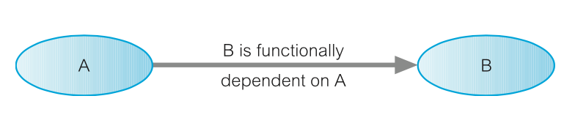
Characteristics of Functional Dependencies
Assuming we know the value of A and we examine the relation that holds the dependency, we find only one value of B in a all the tuples that have a given value of A, at any moment in time. Therefore, two tuples with the same value of A also have the same value of B. However, for a given value of B, there may be several different values of A
The dependency between attributes A and B is represented as shown above.

Slide 20
Determinant
In a functional dependency, the attribute or group of attributes on the left-hand side is referred to as the Determinant.
A is the determinant of B in the functional dependency above

Slide 21
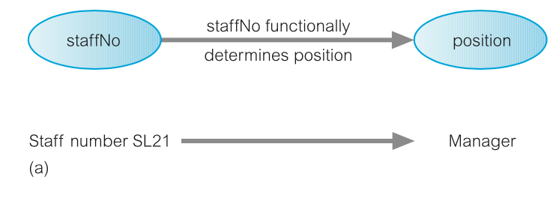
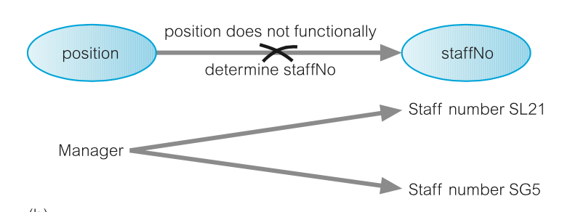
Example of Functional Dependency*
Consider the attribute staffNo and position of the Staff in the Staff and Branch relation. For a specific staffNo, we can determine the corresponding position of that staff. (i.e. staffNo functionally determines position)
The opposite is not true as position does not functionally determine staffNo

Slide 22
Example of Functional Dependency*
The relationship between staffNo and position is one-to-one (1:1) ( i.e. for each staff number there is only one position).
The relationship between position and staffNo is one-to-many (1:*) (i.e. Several staff numbers associated with a given position).
StaffNo is the determinant of this functional dependency.

Slide 23
Example of Functional Dependency*
The relationship between staffNo and position is one-to-one (1:1) ( i.e. for each staff number there is only one position).
The relationship between position and staffNo is one-to-many (1:*) (i.e. Several staff numbers associated with a given position).
StaffNo is the determinant of this functional dependency.

Slide 24
Example of Functional Dependency that holds for a long time*
Considering the values for staffNo an sName attributes, for a specific staffNo we can determine the name for that staff.
Therefore, we can conclude that staffNo attributes formally determines the sName attribute and/or sName attribute functionally determines the staffNo attribute.
Assuming the staffBranch relation shows all possible values for staffNo and sName, then the following functional dependency holds
staffNo ® sName
sName ® staffNo

Slide 25
Example of Functional Dependency that holds for a long time*
However, if the values represents a set off values for staffNo and sName attributes at a given moment in time, Then such relationship isn’t of interest.
As the functional dependency wouldn’t hold for all possible values for attributes of the relation. This is known as integrity constraints.
Integrity constraints indicates the limitations on the values a relation can legitimately assume.

Slide 26
Example of Functional Dependency that holds for a long time*
In this case, the relationship between staffNo and sName is one-to-one (1:1): for each staff number there is only one name. On the other hand, the relationship between sName and staffNo is one-to-many (1:*): there can be several staff numbers associated with a given name.
The functional dependency that holds is
staffNo ® sName

Slide 27
Full and Partial Functional Dependency
Additional characteristics of functional dependency necessary for normalization is that their determinant should have the minimal number of attributes necessary to maintain the functional dependency. This is called full functional dependency.
Full functional dependency indicates that if A and B are attributes of a relation, B is fully functionally dependent on A if B is functionally dependent on A, but not on any proper subset of A. (i.e. removal of any attribute from A results in the dependency no longer existing).
Partial functional dependency indicates that if A and B are attributes of a relation, B is partial functional dependent on A if there is some attribute that can be removed from A and yet the dependency still holds.

Slide 28
Example of Partial and Full Functional Dependency
Let’s consider the functional dependency below
staffNo, sName ® branchNo
Each value of (staffNo, sName) is associated with a single value of branchNo
However, It is not a full functional dependency as branchNo is also functionally dependent on a subset of (staffNo, sName) namely staffNo. This is an example of partial functional dependency.
The functional dependency would be
staffNo ® branchNo

Slide 29
Transitive Dependency
A condition where A, B, and C are attributes of a relation such that if A → B and B → C, then C is transitively dependent on A via B (provided that A is not functionally dependent on B or C).
Let’s consider the functional dependency below
staffNo ® sName, position, salary, branchNo, bAddress branchNo ® bAddress
The transitive dependency branchNo → bAddress exists on staffNo via branchNo. In other words, the staffNo attribute functionally determines the bAddress via the branchNo attribute and neither branchNo nor bAddress functionally determines staffNo.

Slide 30
Identifying Functional Dependency
Identifying all functional dependencies between a set of attributes can be achieved if the meaning of each attributes and the relationship between them are well understood through user requirement specification.
However, it may be necessary to for databases designer to provide missing information not provided by user specification.

Slide 31
Example - Identifying Function Dependency using Meaning and Relationship *
Assuming that the position held and the branch determine a member of staff’s salary. We identify the functional dependencies based on our understanding of the attributes in the staffBranch relation as:
staffNo ® sName, position, salary, branchNo, bAddress
branchNo ® bAddress
bAddress ® branchNo
branchNo, position ® salary
bAddress, position ® salary
We identify five functional dependencies with staffNo, branchNo, bAddress, (branchNo, position), and (bAddress, position) as determinants. For each functional dependency, we ensure that all the attributes on the right-hand side are functionally dependent on the determinant on the left-hand side.

Slide 32
Identifying Function Dependency using Sample data*
In a case where functional dependencies are to be identified in the absence of appropriate information about the meaning of attributes and their relationships, it may be possible to identify functional dependencies if sample data is available that is a true representation of all possible data values that the database may hold.

Slide 33
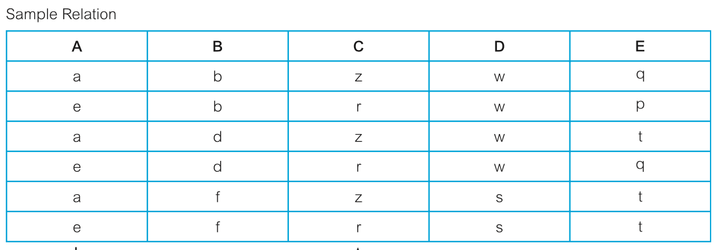
Example - Identifying Function Dependency using Sample data*
Consider the data for attributes denoted A, B, C, D, and A in the Sample relation below
First, it is important to establish that the data values shown in this relation are representative of all possible values that can be held by attributes A, B, C, D, and E.

Slide 34
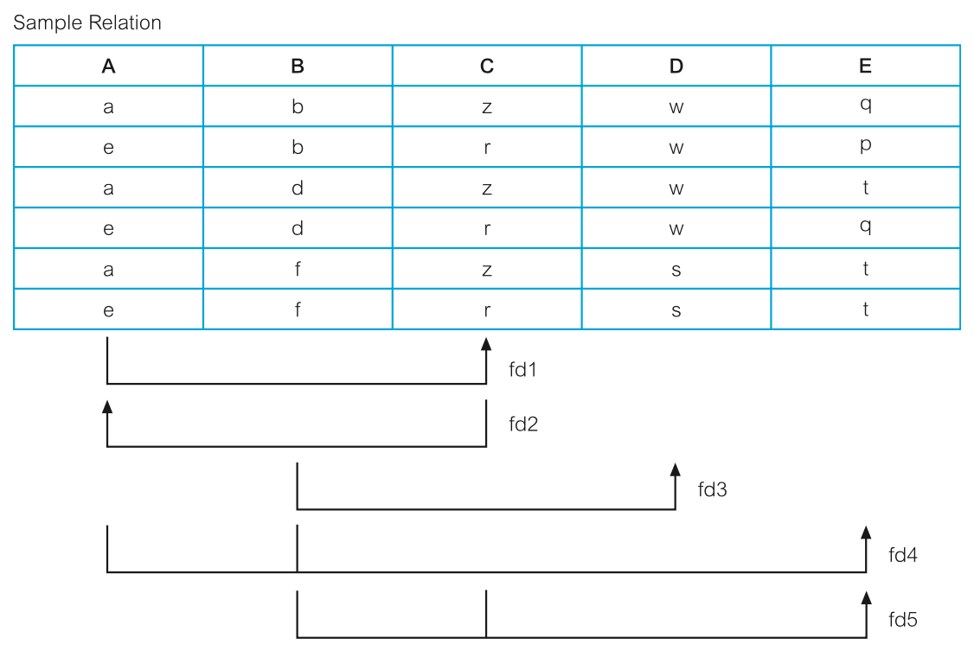
Example - Identifying Function Dependency using Sample data*
Let’s assume that the values represents all possible values that can be held by attributes A, B, C, D, and E. The process of identifying the functional dependencies (denoted fd1 to fd5) that exist between the attributes of the Sample relation is shown below

Slide 35
Example - Identifying Function Dependency using Sample data*
To identify the functional dependency, Starting with the first column on the left-hand side and working towards the right-hand side, we examine the Sample relation and identify when values in one column are consistent with the presence of particular values in other columns.
For example, when the value “a” appears in column A, the value “z” appears in column C, and when “e” appears in column A, the value “r” appears in column C. We can therefore conclude that there is a one-to-one (1:1) relationship between attributes a and C. In other words, attribute a functionally determines attribute C and this is shown as functional dependency 1 (fd1)

Slide 36
Example - Identifying Function Dependency using Sample data*
In summary, we describe the function dependencies between attributes A to E in the Sample relation as shown below:
A®C (fd1)
C®A (fd2)
B®D (fd3)
A,B®E (fd4)
B,C®E (fd5)

Slide 37
Identifying Relation’s Primary Key using Functional Dependency
Recalling that the aim of identifying a set of functional dependencies for a relation is to specify the set of integrity constraints that must hold on a relation.
The first integrity constraint to consider is the identification of candidate keys, one of which is selected to be the primary key for the relation.

Slide 38
Example - Identifying Relation’s Primary Key using Functional Dependency
Recalling the determinants functional dependencies identified earlier for the staffBranch relation staffNo, branchNo, bAddress, (branchNo, position), and (bAddress, position).
(Slide 31)
Identifying the candidate key(s) for the StaffBranch relation, requires identifying the attribute (or group of attributes) that uniquely identifies each tuple in this relation.
For relation with more than one candidate key, we identify the candidate key that is to act as the primary key for the relation.
All attributes that are not part of the primary key (non-primary-key attributes) should be functionally dependent on the key.

Slide 39
Example - Identifying Relation’s Primary Key using Functional Dependency
The only candidate key of the StaffBranch relation, and therefore the primary key, is staffNo, as all other attributes of the relation are functionally dependent on staffNo.
Although branchNo, bAddress, (branchNo, position), and (bAddress, position) are determinants in this relation, they are not candidate keys for the relation.

Slide 40
The Process of Normalization
Recalling normalization as a formal technique for analyzing relations based on their primary key (or candidate keys) and functional dependencies (Codd, 1972b).
The process of normalization involves a series of rules used to test individual relations so that a database can be normalized to any degree.

Slide 41
The Process of Normalization
Relations violating requirement must be decomposed into relations that individually meet the requirement of normalization.
Three normal forms called First Normal Form (1NF), Second Normal Form (2NF), and Third Normal Form (3NF) were initially used. Subsequently, an introduction of Boyce–Codd Normal Form (BCNF) is as a result of stronger definition of the third normal form by R. Boyce and E. F. Codd.

Slide 42
The Process of Normalization
With the exception of 1NF, all these normal forms are based on functional dependencies among the attributes of a relation (Maier, 1983).
Higher normal forms that go beyond BCNF were introduced later such as Fourth Normal Form (4NF) and Fifth Normal Form (5NF) (Fagin, 1977, 1979). However, these later normal forms deal with situations that are very rare. As such we shall not be covering them.
Normalization is often executed as a series of steps with each step corresponding to a specific normal form that has known properties.

Slide 43
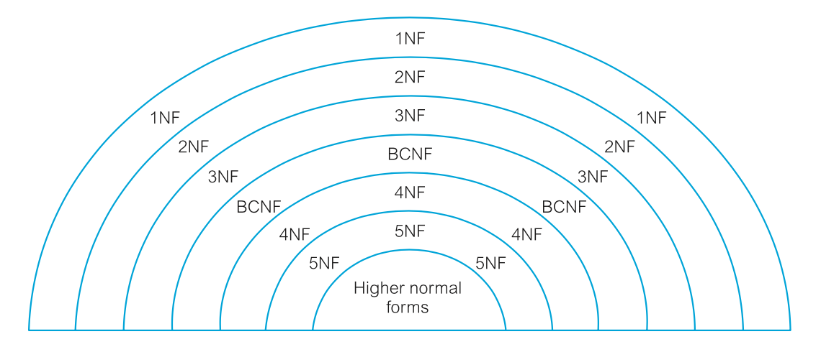
The Process of Normalization
As normalization proceeds, the relations become progressively more restricted in format and also less vulnerable to update anomalies.
For the relational data model, it is important to recognize that it is only First Normal Form (1NF) that is critical in creating relations; all subsequent normal forms are optional.
In other to avoid the update anomalies, it is recommended that we proceed to at least Third Normal Form (3NF).

Slide 44
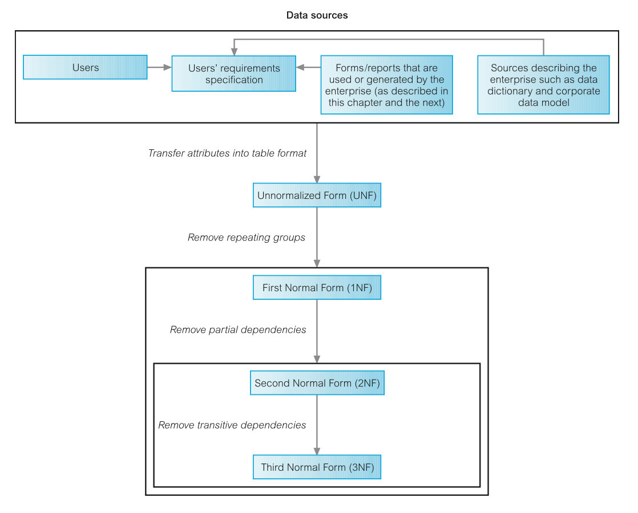
The Process of Normalization

Slide 45
Part 2
Normal Form

Slide 46
First Normal Form (1NF)
Recalling that an Unnormalized form (UNF) is a table that contains one or more repeating groups.
We could define 1NF as a relation in which the intersection of each row and column contains one and only one value.
The process of normalization starts by first transferring the data from the source into table format with rows and columns.
This format is referred to as the UNF
To transform the table into 1NF, repeated groups within the table must be identified and removed.
A repeating group is an attribute, or group of attributes, within a table that occurs with multiple values for a single occurrence of the nominated key attribute(s) for that table.

Slide 47
First Normal Form (1NF)
Two common approaches are employed to removing repeating groups from unnormalized tables:
Entering appropriate data in the empty columns of rows containing the repeating data. This process is also known as the Flattening process
Placing the repeating data, along with a copy of the original key attribute(s), in a separate relation.
The resulting table used by either of the two approaches is referred to as the 1NF relations containing single values at the intersections of each row and column.

Slide 48
First Normal Form (1NF)
Two common approaches are employed to removing repeating groups from unnormalized tables:
Entering appropriate data in the empty columns of rows containing the repeating data.
Placing the repeating data, along with a copy of the original key attribute(s), in a separate relation.
The resulting table used by either of the two approaches is referred to as the 1NF relations containing single values at the intersections of each row and column.

Slide 49
First Normal Form (1NF)
Although both approaches are valid, approach 1 introduces more redundancy into the original UNF table as part of the “flattening” process, whereas approach 2 creates two or more relations with less redundancy than in the original UNF table.

Slide 50
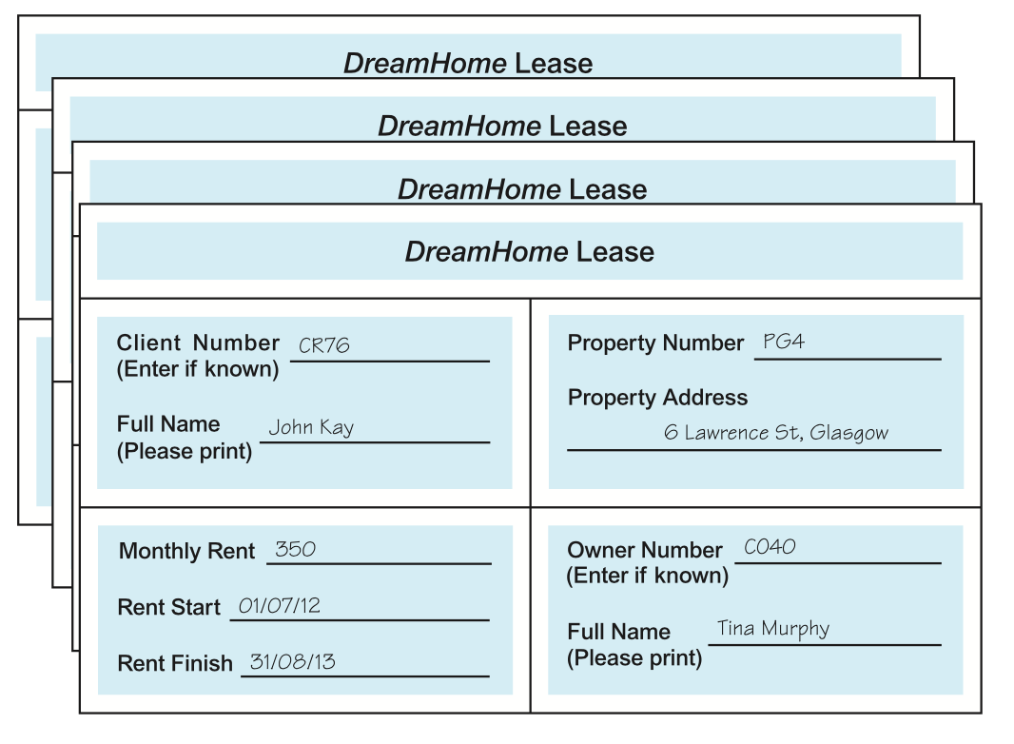
Example - First Normal Form (1NF)
Consider a collection of DreamHome lease shown below. For this example we assume that a client rents a given property only once and cannot rent more than one property at any one time.

Slide 51
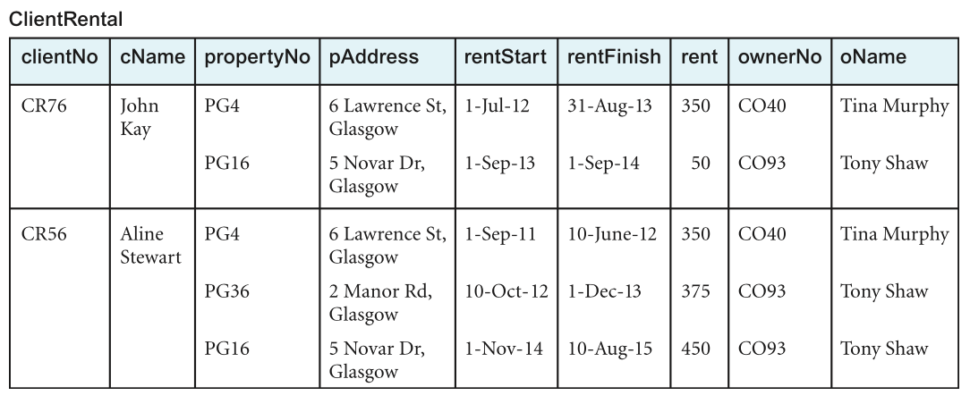
Example - First Normal Form (1NF)
Assuming sample data is taken from two leases for two different clients called John Kay and Aline Stewart and is transformed into table format with rows and columns, as shown in below
This is an example of an unnormalized table.

Slide 52
Example - First Normal Form (1NF)
First, from the UNF, we can identify the key attributes as clientNo.
Next, we identify the repeating group in the unrealized table as the property rented details, which repeats for each client. The structure of the repeating group is:
Repeating Group = (propertyNo, pAddress, rentStart, rentFinish, rent, ownerNo, oName)
As there are multiple values at the intersection of certain rows and columns.(e.g. there are two values for propertyNo (PG4 and PG16) for the client named John Kay). To transform an unnormalized table into 1NF, we ensure that there is a single value at the intersection of each row and column. This is achieved by removing the repeating group.

Slide 53
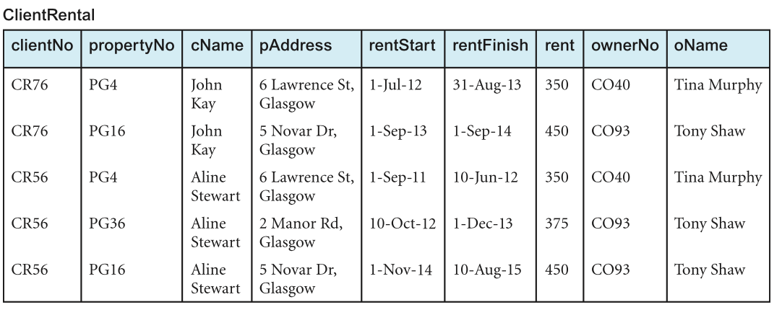
Example - First Normal Form (1NF)
Using the first approach, we arrive at the first normal form ClientRental relation by removing the repeating group (property rented details) by entering the appropriate client data into each row.

Slide 54
Example - First Normal Form (1NF)
Using the functional dependencies discussed earlier, we can identify candidate keys for the ClientRental relation as being composite keys comprising (clientNo, propertyNo), (clientNo, rentStart), and (propertyNo, rentStart).
Using (clientNo, propertyNo) as the primary key for the relation, and for clarity we place the attributes that make up the primary key together at the left-hand side of the relation. In this example, we assume that the rentFinish attribute is not appropriate as a component of a candidate key as it may contain nulls.

Slide 55
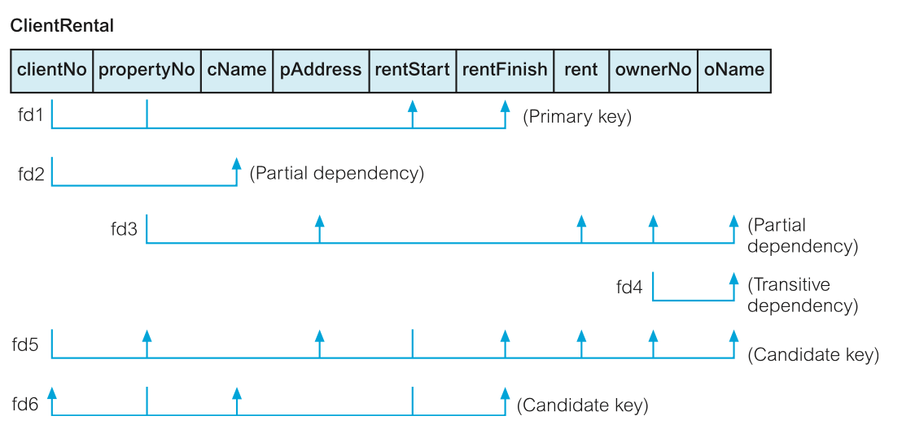
Example - First Normal Form (1NF)

Slide 56
Example - First Normal Form (1NF)
The ClientRental relation is defined as follows:
ClientRental (clientNo, propertyNo, cName, pAddress, rentStart, rentFinish, rent, ownerNo, oName)
The ClientRental relation is in 1NF, as there is a single value at the intersection of each row and column. The relation contains significant data redundancy as data describing clients, property rented, and property owners, is repeated several times. This 1NF would be subjected to update anomalies if implemented. Transforming the relation into second normal would remove some.

Slide 57
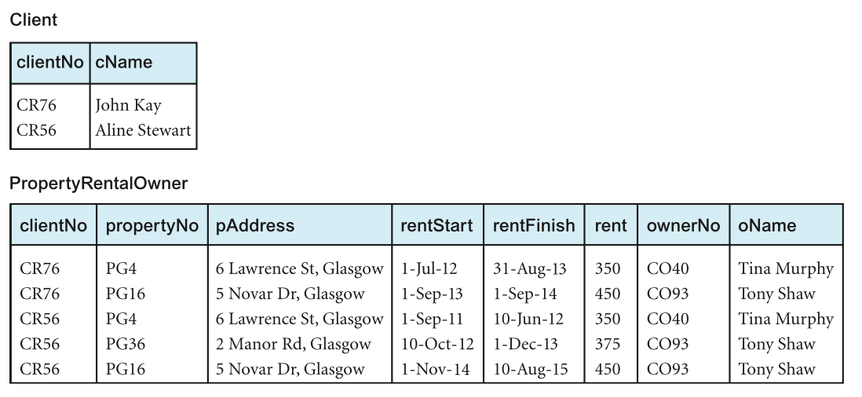
Example - First Normal Form (1NF)
Using the second approach, we remove the repeating group (property rented details) by placing the repeating data along with a copy of the original key attribute (clientNo) in a separate relation

Slide 58
Example - First Normal Form (1NF)
With the help of the functional dependencies identified previously we identify a primary key for the relations. The format of the resulting 1NF relations are as follows:
Client (clientNo, cName) PropertyRentalOwner (clientNo, propertyNo, pAddress, rentStart, rentFinish, rent, ownerNo, oName)

Slide 59
Example - First Normal Form (1NF)
The Client and PropertyRentalOwner relations are both in 1NF, as there is a single value at the intersection of each row and column. The Client relation contains data describing clients and the PropertyRentalOwner relation contains data describing property rented by clients and property owners.
However, this relation also contains some redundancy and as a result may suffer from similar update anomalies.

Slide 60
Second Normal Form (2NF)
Is a relation that is in first normal form and every non-primary-key attribute is fully functionally dependent on the primary key.
The normalisation of 1NF relations to 2NF involves the removal of partial dependencies. If a partial dependency exists, we remove the partially dependent attribute(s) from the relation by placing them in a new relation along with a copy of their determinant.

Slide 61
Second Normal Form (2NF)
To demonstrate the process of normalising relations from 1NF to 2NF, we would use only the ClientRental relation. However, recall that both approaches are correct, and will ultimately result in the production of the same relations as we continue the process of normalization.

Slide 62
Example - Second Normal Form (2NF)
Recalling that the ClientRental relation has the following functional dependencies:
fd1 clientNo, propertyNo ® rentStart, rentFinish (Primary key)
fd2 clientNo ® cName (Partial dependency)
fd3 propertyNo ® pAddress, rent, ownerNo, oName (Partial dependency)
fd4 ownerNo ® oName (Transitive dependency)
fd5 clientNo, rentStart ® propertyNo, pAddress, (Candidate key)
rentFinish, rent, ownerNo, oName
fd6 propertyNo, rentStart ® clientNo, cName, (Candidate key)
rentFinish

Slide 63
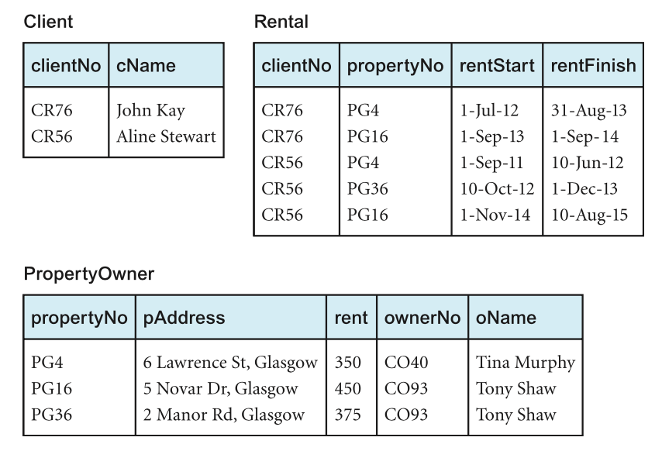
Example - Second Normal Form (2NF)

Slide 64
Example - Second Normal Form (2NF)
Using these functional dependencies, we continue the process of normalizing the ClientRental relation.
We start by testing whether the ClientRental relation is in 2NF by identifying the presence of any partial dependencies on the primary key.
We note that the client attribute (cName) is partially dependent on the primary key, in other words, on only the clientNo attribute (represented as fd2).

Slide 65
Example - Second Normal Form (2NF)
The property attributes (pAddress, rent, ownerNo, oName) are partially dependent on the primary key, that is, on only the propertyNo attribute (represented as fd3).
The property rented attributes (rentStart and rentFinish) are fully dependent on the whole primary key; that is the clientNo and propertyNo attributes (represented as fd1).

Slide 66
Example - Second Normal Form (2NF)
Identification of partial dependencies within the ClientRental relation indicates that the relation is not in 2NF.
To transform the ClientRental relation into 2NF requires the creation of new relations so that the non-primary-key attributes are removed along with a copy of the part of the primary key on which they are fully functionally dependent.

Slide 67
Example - Second Normal Form (2NF)
This results in the creation of three new relations called Client, Rental, and PropertyOwner. These three relations are in second normal form, as every non-primary-key attribute is fully functionally dependent on the primary key of the relation.
Client (clientNo, cName) Rental (clientNo, propertyNo, rentStart, rentFinish)
PropertyOwner (propertyNo, pAddress, rent, ownerNo, oName)

Slide 68
Third Normal Form (3NF)
Is a relation that is in first and second normal form in which non-primary-key attribute is transitively dependent on the primary key.
The normalization of 2NF relations to 3NF requires updating two tuples in the relation. If only one tuple is updated and not the other, the database would be in an inconsistent state.
This anomaly is caused by a transitive dependency, we need to remove such dependencies by progressing to third normal form.
The normalization of 2NF relations to 3NF involves the removal of transitive dependencies. If a transitive dependency exists, we remove the transitively dependent attribute(s) from the relation by placing them in a new relation along with a copy of their determinant.

Slide 69
Example - Third Normal Form (3NF)
Recalling that the Client, Rental and propertyOwner relation has the following functional dependencies:
Client fd2 clientNo ® cName (Primary key)
Rental fd1 clientNo, propertyNo ® rentStart, rentFinish (Primary key)
fd5' clientNo, rentStart ® propertyNo, rentFinish (Candidate key)
fd6' propertyNo, rentStart ® clientNo, rentFinish (Candidate key)
PropertyOwner
fd3 propertyNo ® pAddress, rent, ownerNo, oName (Primary key)
fd4 ownerNo ® oName (Transitive dependency)

Slide 70
Example - Third Normal Form (3NF)
All non-primary-key attributes in Client and Rental relations are functionally dependent on only their primary keys. They have no transitive dependencies and therefore already 3NF.
Like in Client and Rental relations, all non-primary-key attributes in PropertyOwner relation are functionally dependent on the primary key, with the exception of oName, which transitively dependent on ownerNo.
Transforming the PropertyOwner relation into 3NF, we must first remove the transitive dependency.
This is done by creating 2 new relations;
PropertyForRent
Owner
PropertyForRent (propertyNo, pAddress, rent, ownerNo)
Owner (ownerNo, oName)

Slide 71
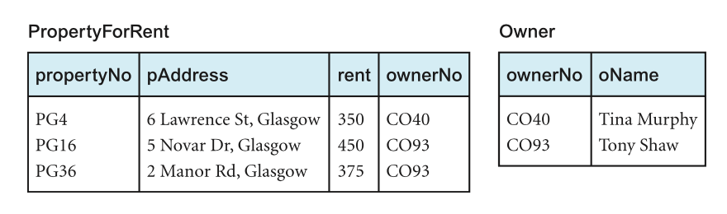
Example - Third Normal Form (3NF)
This are in 3NF and there’s no further transitive dependency on the primary key

Slide 72
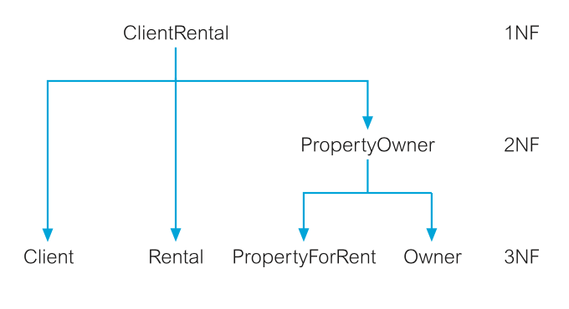
Example - Third Normal Form (3NF)
Using the process of normalisation, the ClientRental relation introduced in slide 48 has been transformed into a 3NF.
The resulting 3NF relation as shown above have the form
Client (clientNo, cName) Rental (clientNo, propertyNo, rentStart, rentFinish)
PropertyForRent (propertyNo, pAddress, rent, ownerNo)
Owner (ownerNo, oName)

Slide 73
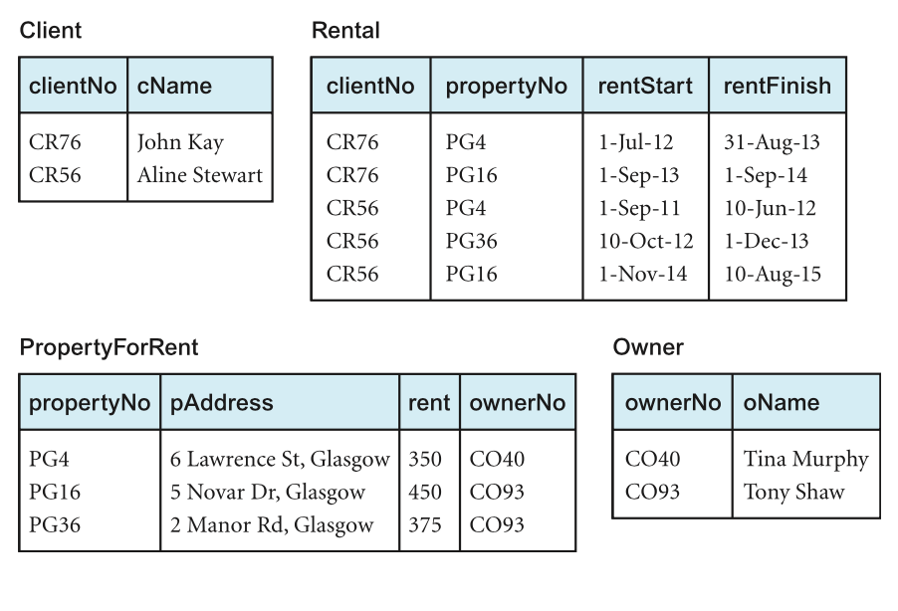
Example - Third Normal Form (3NF)

Slide 74
Natural Join Operation
The original ClientRental relation can be recreated by joining the Client, Rental, PropertyForRent, and Owner through the primary key/foreign mechanism.
The ownerNo attribute is a primary key within the Owner relation and is also present within the PropertyForRent relation as a foreign key.
The ownerNo attribute acting as a primary key/foreign key allows the association of the PropertyForRent and Owner relations to identify the name of property owners.

Slide 75
Natural Join Operation
The clientNo attribute is a primary key of the Client relation and is also present within the Rental relation as a foreign key. Note that in this case the clientNo attribute in the Rental relation acts both as a foreign key and as part of the primary key of this relation.
The propertyNo attribute is the primary key of the PropertyForRent relation and is also present within the Rental relation acting both as a foreign key and as part of the primary key for this relation.

Slide 76
Summary
We have demonstrated how normalization can be used to decompose original relation using series of relational algebra projections.
This results in a lossless-join decomposition, which is reversible using natural join operation.

Slide 77
Next Week
Structured Query Language

